Slide 1
“Congestion Reduction in Europe: Advancing Transport Efficiency”
C R E A T E

Slide 2
Context
CREATE is part of the CIVITAS initiative
The 2014 urban mobility projects under Horizon 2020 are branded “knowledge generating projects” and cover 3 topics:
Transforming the use of conventionally fuelled vehicles
Reducing the impact of freight and service trips
Tackling urban Road congestion
CREATE is under the 3rd one and will cooperate with other CIVITAS projects.

Slide 3
18 Partners from 11 Countries
Universities
Private Company & Consultants
City network
10 Cities

Slide 4
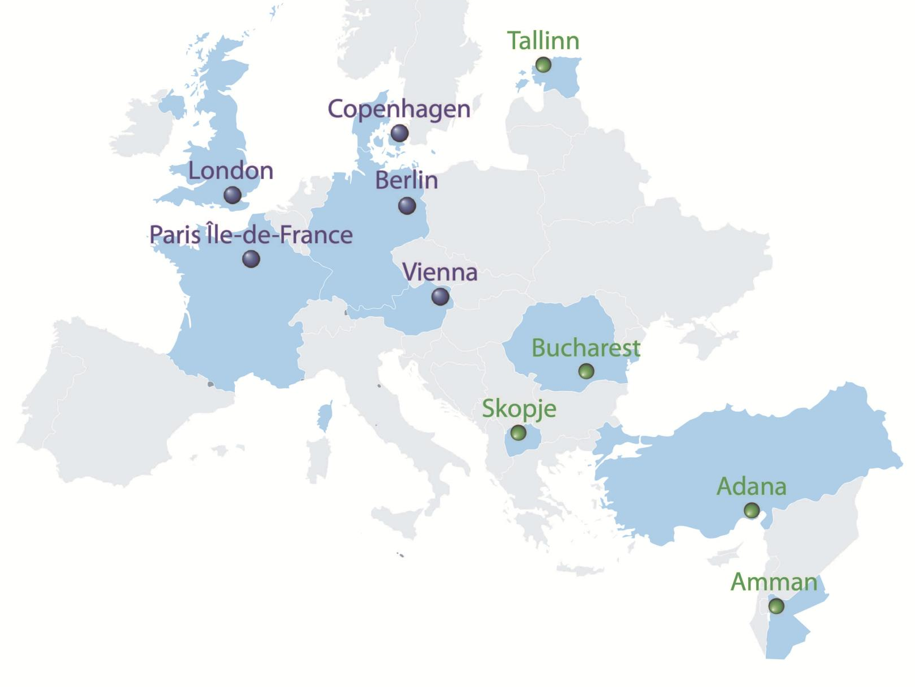
10 European and Euro-Med Cities

Slide 5
What is CREATE about?
A project for cities and with cities
The project addresses the challenging problems of dealing with car use faced by most cities in Europe and beyond.
It will identify ways to deal with the consequences of future population growth and associated mobility densification, through new technologies, business models and social practices.

Slide 6
CREATE fundamental aim
CREATE aims to establish :
which policies are most effective at reducing congestion and promoting sustainable transport,
whether such policies are transferable to other cities, and
how cities are going to respond to the challenges of rapid population growth and new transport technologies in the future.

Slide 7
CREATE primary goal
CREATE searches to inform cities on how best to
reduce congestion and
improve transport network performance
by
lowering levels of car use (or moderating the rate of growth in rapidly developing economies),
encouraging sustainable mobility and
becoming a liveable city.

Slide 8
A CREATE-ive approach
CREATE helps cities to
decouple economic growth and high mobility from traffic growth
create a sustainable transport system
Most cities around the world are at different stages of an evolutionary transport policy development process…

Slide 9
Stage 1 Cities
Cities with “pro-car” policies are characterized by rapid urban economic growth linked to the growth of car ownership and use. They prioritise major road building and new car parking.

Slide 10
Stage 2 Cities
Cities facing problems associated with increased car use, such as congestion and pollution, introduce policies to provide better public transport alternatives and limit car access to city centres.

Slide 11
Stage 3 Cities
Cities aspire to become “liveable cities” by encouraging street activities, relocating road space to public transport, and promoting walking and cycling.

Slide 12
Can this evolutionary/learning process be short-circuited?
→ CREATE promotes knowledge transfer to stage 1 cities and supports them in short-circuiting this evolutionary process, to become more liveable and sustainable.

Slide 13
Objectives
Tackling Urban Road Congestion
Develop concrete guidance for cities
Address the challenge of ‘mobility densification’
Produce knowledge transfer and exploitation material
Investigate nature and causes of urban road congestion
Examine how to reduce car use and promote liveability
Notes:
1. Investigate nature and causes of urban road traffic congestion:
→ Improved measures of congestion and network performance
2. Examine how 5 Western European cities have succeeded in reducing car use and developing a more liveable city
→ Both quantitatively & qualitatively
3. Develop concrete guidance for ‘Eastern European’ cities on how to reduce car use and promote liveability
→ Including development of business cases

Slide 14
Positioning of the project
CREATE focuses on:
Developing new congestion and network performance indicators and insights into how cities can reduce car use,
Making a business case for investing in sustainable mobility infrastructure and measures.

Slide 15
Methodological approach
User needs analysis
Data collection and collation
Data analysis
Synthesis of findings
International experiences
Future city challenges
Dissemination, Exploitation, Capacity Building and Knowledge Transfer

Slide 16
User needs analysis
To engage with the appropriate internal and external stakeholders and to refine set of project outputs.
Includes:
Policy processes and outcomes
Indicators of congestion and network performance
Involves:
face-to-face workshops with Stage 3 city partners,
a ‘sounding board’ group of cities included on our Stakeholder Engagement Group (SEG)
Notes:
Part of this activity involves a detailed investigation of indicators of urban congestion and network performance: what measures do cities currently use, and how might these be expanded to give a broader understanding of mobility provision in cities, taking advantage of opportunities provided by new forms of electronic data collection? The outcome of this process will be a refined set of requirements for the CREATE project outputs, which will feed into all subsequent phases of work.

Slide 17
Data collection and collation
4 kinds of data:
Observational data: to measure congestion and network performance (traffic counts, speed measurements, GPS and mobile phone data).
Behavioural data: to track changes in behaviour (existing household travel survey data, such as car driver modal shares).
Quantitative data: to explain statistically the observed changes in behaviour (supply and contextual variables).
Qualitative data: to describe the Transport Policy Evolution Cycle in each Stage 3 city (process factors / implementation of sustainable mobility policies).
Notes:
traffic counts, speed measurements, GPS and mobile phone data
mainly in the form of existing household travel survey data at multiple points in time (e.g. car driver modal shares)
supply variables (representing levels and quality of transport provision) and contextual variables (e.g. growth in GDP)
This will involve group discussions and individual interviews, as well as collation of policy documents, press articles, etc.

Slide 18
Data analysis
Main forms of analysis include:
Compilation of new indicators of congestion and network performance, and comparison with current measures, spatially and temporally, including mapping.
Descriptive analysis of travel behaviour and showing trends over time.
Statistical modelling of changes in travel behaviour
Analysis of qualitative data on the policy development process in Stage 3 cities
These very different forms of data enquiry are combined.
Notes:
2. Descriptive analysis of travel behaviour (trip rates, trip lengths, trip purposes, modal shares, etc.) by population group, time of day, area of the city region, etc.
3. relating observed patterns to changes in the potential explanatory variables, population characteristics, transport supply conditions, etc.
4. using various methods, ranging from content analysis to process analysis
WPs 3 and 4 lie at the heart of the CREATE project, and they will provide complementary information on the nature of the Transport Policy Evolution Cycle as experienced in our five Stage 3 cities.
It is unusual to combine these very different forms of data enquiry; some partners have had experience of doing this in previous projects and expect it to yield very rich and practical insights.
Analysing the qualitative dimension of policy processes will provide an informed assessment of how the shift from Stage 1 to Stage 3 was achieved: what do cities do as part of their urban sustainable mobility policy agenda? Why and how did they favour a given strategy? What were the main factors of change over time, and how was it introduced, e.g., gradually or overnight? This is done in a comparative perspective between the five Stage 3 cities in order to identify similarities and differences across the case studies.
→ CREATE provides a unique opportunity to carry out this kind of historical and in-depth analysis, as many of the key professionals with a long time span of policy knowledge in their city will shortly be retiring.

Slide 19
Synthesis of findings
At various levels:
Comparing the results of the quantitative analyses across the five Stage 3 cities
general conclusions
cross-site conclusions
Combining the qualitative and quantitative analyses
high-level conclusions and recommendations
Will result in a major technical output of the CREATE project: a new set of Guidelines.
Notes:
high-level conclusions and recommendations
→ backed up by insights from previous European and international studies, and the wider knowledge of the project partners
→ will include advice on which kinds of measures are more likely to achieve reductions in car use and congestion in particular contexts, and how to develop businesses cases or investment in such policy measures

Slide 20
Future city challenges
How new technologies and social and business practices
might affect the demand for mobility ?
could more generally contribute to more sustainable living patterns in cities ?
This task will draw on:
the extensive literature on socio-technical systems
international experiences
work on future mega trends likely to affect cities.
Notes:
This work will draw on the extensive literature on socio-technical systems (e.g. Marletto, 2014) and be of particular interest to our CREATE city partners who are expecting to face a rapid increase in population in the coming decades, and an associated ‘densification’ of mobility demand which could overwhelm current transport systems.
This task will also draw on international experiences – for example, the recent work on Autonomous Vehicle Technology for the Rand Corporation (Anderson et al, 2014) - and take into account work on future mega trends likely to affect cities (e.g. Sing, 2012 and Watson, 2012).
It will also involve other EUROCITIES members with a particular interest in this topic.

Slide 21
Dissemination, Exploitation, Capacity Building and Knowledge Transfer
Wide variety of methods
to ensure that the relevant target groups either have the opportunity to contribute to the work of the project, or benefit from it in the most appropriate manner
Strong emphasis on knowledge transfer
among all the city partners
linked to capacity building both internally and externally
Strong mechanisms for the exploitation of the key findings
among a wide range of cities, university teaching departments
with a view to developing commercially exploitable new empirical indictors of city network performance
Notes:
External contributions to the project are particularly sought at the initial stage of user needs analysis, through workshops and an email survey, and to comment on and contribute to the synthesis of findings and the work on future city challenges – as well as the draft Guidelines.

Slide 22
Primary Outputs
Analysis: “Urban congestion & network performance: a new understanding”
Report of cross-city comparisons
Final report on socio-political factors
CREATE guidelines: “Pathways to tackling current congestion and reducing levels of car use in European cities”
Developing a set of effective and politically acceptable Stage 4 city policies: a SUMDP = Sustainable Urban Mobility Densification Plan

Slide 23
Intended Impacts
Change debate about measurement of congestion & network performance
Provide insights into why cities evolve away from car promotion and how – is this universally possible?
Guidance to Stage 1 cities on how - and why - to rapidly advance to Stage 3
Guidance to Stage 3 cities on how to go to Stage 4
Coping with ‘mobility densification’

Slide 24
Coordinator contact: Prof. Peter Jones, CTS
Scientific coordinator University College London peter.jones@ucl.ac.uk
Communication contact:
Vanessa Holve
Policy advisor and project coordinator
EUROCITIES
vanessa.holve@eurocities.eu
CREATE has received funding from the European Union’s Horizon 2020 research and innovation programme under
grant agreement N°636573

Slide 25
Thank You!
www.create-mobility.eu

